Slide 1
EEG Component Analysis Through Artificial Neural Network Implementation to Distinguish Neurological Processes
By: Lela Bones and Mahmoud Yousif

Slide 2
Accomplishments
1
Used NodeJS as a platform for data collection
2
Completed IRB form
3
Applied for Henson Research Grant
Plan on submitting next week

Slide 3
NodeJs Demonstration
Express.js
Creates a back-end that will handle connection to openbci
Servers a survey file to web browser
Openbci.js
Openbci’s Node.js api for connection to the headset
JSPsych
Engine that runs survey through html plugins
Designed blink-test

Slide 4
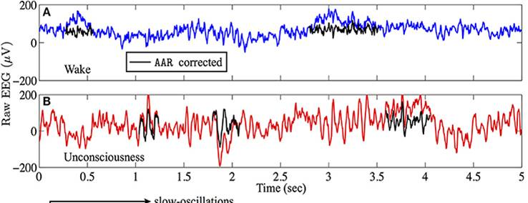
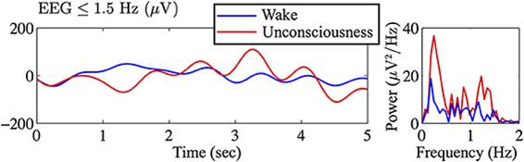
Fast Fourier Transformation

Slide 5
Research Paper
https://www.overleaf.com/read/zhvcjdbfvymf

Slide 6
IRB Form
https://www.overleaf.com/read/zhvcjdbfvymf

Slide 7
Future Goals
Start conducting experiments and perfect data collecting methods
Filter through the data and train artificial neural nets
Create program that detects certain motions and signals for a response
Wire it up to hardware (e.g. Drones, Robotic Arm, CPUs, etc.)
If we receive funding
We will use additive manufacturing to print our robotic arm
We will update our helmet with extra components

